Slide 1
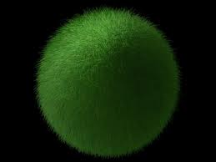
Towards Consistent Nonlocal Theories of Gravity
Adventures in Superspace
McGill University, 2013
Tirtho Biswas

Slide 2
My Collaborators
N. Barnaby (U of M)
R. Brandenberger (McGill)
J. Cembranos (Madrid)
J. Cline (McGill)
E. Gerwick
M. Grisaru (McGill)
J. Kapusta (U of M)
T. Koivisto (Utrecht)
A. Kosheylev (BrusselNs)
A. Mazumdar (Lancaster)
A. Reddy (U of M)
W. Siegel (Stony Brook)
S. Vernov (Moscow)
g. B708 (2005) 317-344
with M. Grisaru & W. Siegel,
Nucl. Phys. B708, 317 (2005)
with J. Cembranos and J. Kapusta,
PRL 104, 021601 (2010)
[arXiv:0910.2274 [hep-th]]
with E. Gerwick, T. Koivisto and A. Mazumdar,
PRL 108, 031101 (2012)
[arXiv:1110.5249 [gr-qc]]

Slide 3
Nonlocal Actions in String Theory
String Field Theory Tachyons
[Witten, Kostelecky & Samuel, Sen]
p-adic string theory [Volovich, Brekke, Freund, Olson, Witten, Frampton]
Mass square has the wrong sign
An inifinte series of higher derivative kinetic operators, mildly nonlocal
open string coupling string tension

Slide 4



t’ Hooft dual to string theory
Polyakov action:
Strings on Random lattice [Douglas & Shenker]
Dual Field theory action
One can compute the Feynman diagrams and even sum them up
  We found linear Regge trajectories. [TB, Grisaru & Siegel]

Slide 5
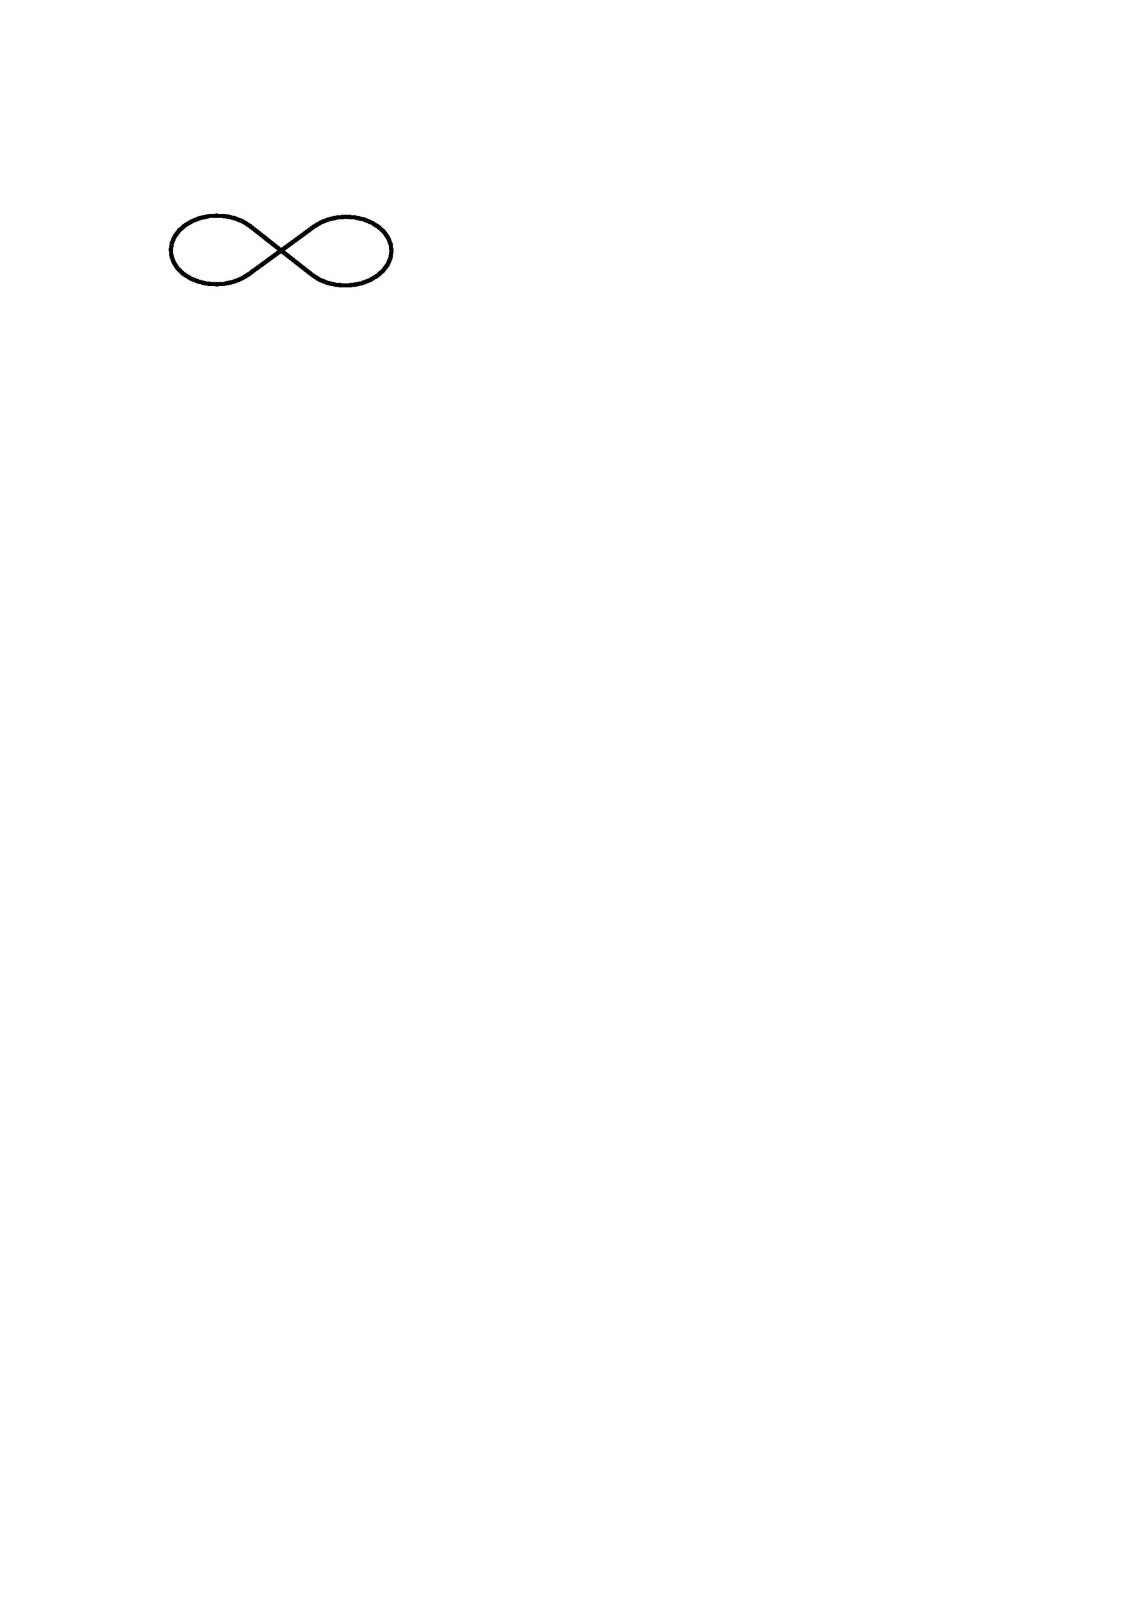
Interesting Properties
Ghostfree
But SFT/padic type theories have no extra states!
Quantum loops are finite
UV under better control, like usual HD theories
Thermal duality in p-adic strings
[TB, Cembranos & Kapusta, 2010 PRL]
Can there be any phenomenological implications for LHC?

Slide 6
Applications
Insights into string theory
Brane Physics & Tachyon condensation [Zwiebach & Moeller; Forini, Gambini & Nardelli; Colleti, Sigalov & Taylor; Calcagni…]
Hagedorn physics [Blum; with Cembranos & Kapusta]
Spectrum [with Grisaru & Siegel, Minahan]
Applications to Cosmology
Novel kinetic energy dominated non-slow-roll inflationary mechanisms [with Barnaby & Cline; Lidsey…]
Dark Energy [Arefeva, Joukovskaya, Dragovich, ...]

Slide 7
Nonlocal Gravity
Can Nonlocal higher derivative terms be free from ghosts?
Can they address the singularity problems in GR?
What about quantum loops?
  Stelle demonstrated 4th order gravity to be renormalizable (1977), but it has ghosts

Slide 8
Ghosts
From Scalars to Gravity
The metric has 6 degrees (graviton, vector, and two scalars)
Gauge symmetry is subtle, some ghosts are allowed
Several Classical (time dependent) backgrounds.

Slide 9
Linearized Gravity
It’s good for
Ghosts
Perturbations and stability
Solar system tests
The most general covariant action with metric and Box
We have looked at Minkowski, but (A)dS should be tractable
Only interested in quadratic fluctuations. Therefore for Minkowski

Slide 10
What about fluctuations around (A)dS?
If we have more than 3 operators, they don’t contribute because
By repeated integration by parts the relevant part becomes
Since P₃ takes the background values up to O(h²) we have
There are 14 terms involving Ricci scalar, Weyl and S-tensor symmetric and traceless)
Covariant derivative commutations rise & Bianchi identities

Slide 11
Action around (A)dS & Minkowski
Exorcism in Minkowski vacuum
Covariant derivatives must be Minkowski [van Nieuwenhuizen & Sezgin]
We noticed a+b = c+d =f+c-a=0

Slide 12
By inverting Field equations we obtain the propagators
Decouple the different multiplets using projection operators,
would have gotten the wrong sign but is absent because of the relations which follow from BI
The propagator is of the form
  In GR a = c = 1, scalar ghost cancels the longitudinal mode
  a has to be an entire function, otherwise Weyl ghosts
  a-3c can have a single zero -> f(R)/Brans-Dicke theory
  Exponential non-local Gravity,

Slide 13
Newtonian Potentials
Large r, reproduces gravity; small r, asymptotic freedom
Gravity Waves
Similar arguments imply nonsingular Green’s functions for quadrupole moments

Slide 14
Emergent Cosmology
Space-time begins with pure vacuum
You cannot find a consistent solution for GR
There must be a scalar degree of freedom

Slide 15
Exact Solutions
Bouncing Solutions
deSitter completions, a(t) ~ cosh(Mt)
Stable attractors, but there are singular attractors.
Can provide a geodesically complete models of inflation.
Perturbations can be studied numerically and analytically, reproduces GR at late times [in progress]

Slide 16
Conclusions
Nonlocal gravity is a promising direction in QG
It can probably solve the classical singularities
How to constrain higher curvatures?
  New symmetries
  Look at ghost constraints on (A)dS – relevant for DE
Can we implement Stelle’s methods?

